Slide 1
ClickStream Project Part 1 622 – Behavioral Analytics Dr. Zhou Group 4 Cynthiya Mahumane & Ariana Sampson

Slide 2

Project analysis slide 2
Goal & Strategy
Why some people spend more time and view more pages when booking hotels?
Explorative Analysis
What the data shows, summary statistics, visual representation (Scatterplot & Histograms)
Regression Analysis
Influencing factors, relationships between variables, causality
Notes:
For this Clickstream Project, our goal was to find out why some people spend more time and view more pages when booking hotels.
In order to reach this goal, we followed our set strategy by making observations and conducting analytics. First, we will look at explorative analysis, where we look at what the data actual shows us and how it's used, a summary statistics on variables of interest, and visual representation which includes a scatterplot and histograms. After that, we conducted a regression analysis. Here we look at what influencing factors attribute towards reaching our goal, the actual relationships between variables, and we try to find the causality for which variables answer our question.

Slide 3
Explorative Analysis

Slide 4
Project analysis slide 3
Website Popularity
Bookings were most generated on hotels and third-party websites.
Hotels for convenience, membership, points
JetBlue for travel package with flight included
Third-party websites for best deal at the cheapest price
Google doubles Yahoo and Bing for usage as most common search engine
JetBlue appears on this list as well, showing popularity of a travel package
Other third-party websites are not contributing factors for initial search
Notes:
Before going into answering our question directly, we first needed to see just how users go about getting their booking. We look at what websites are most popular for users.
On the domain side, the blue, we found that most bookings were generated on hotels, such as the Marriott and Hilton sites, and third-party websites such as hotels.com and expedia. From this we could assess that hotels would be primarily used for convenince or if a user has a membership or points, third-parties for the best overall deal regardless of hotel, and JetBlue, an airline, for its travel packages with included flight.
On the reference domain, the orange, we see where users first go before deciding on a website to use for booking. Google, Yahoo, and Bing, have the most transactions as they are the most common search engines with Google doubling the latter two. An interesting factor is that JetBlue is the only domain that reappears from the Domain side, showing its popularity on a travel package. Lastly, other thirs party websites are not contributing factors for initial search because it shows that users are not actively seeking them out but it ends up being where some users complete a booking.

Slide 5
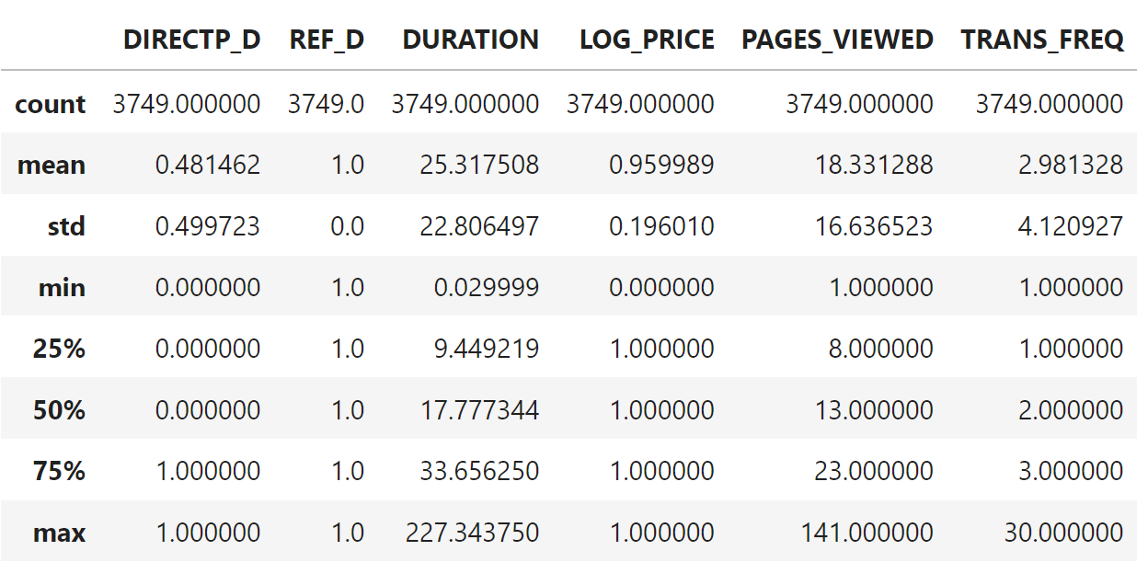
Project analysis slide 4
Summary Statistics
DIRECTP_D
Average amount of transactions occurs on third-party websites
Only by a small margin as mean of .48 is closer to 0
DURATION
Average amount of time spent on a website is 25 minutes
Longer times may attribute to browsing, selecting a deal, filtering, payment, or idleness
Shorter times may attribute to immediate exit, nothing noteworthy, or even bad website design
PAGES
*PAGES_VIEWED
Average amount of pages viewed is about 18
Going through different pages to find a good deal
Results would vary based on DURATION, HOUSEHOLD_SIZE, TRANS_FREQ
Third-party websites = more data to sort through
Could attribute to third-parties offering better deals
*Creation of dummy variables REF_D & LOG_PRICE
REF_D: Transactions were referenced from other websites
LOG_PRICE: Most users paid under $499 for their transactions
Notes:
In this summary statistics, we look at averages and how each transaction compares to overall usage. Dummy variables were created to see where transactions came from and how much users paid. While we did not dive into these variables, they helped when comparing them against others.
The first interpretation we look at is the DIRECTP_D variable, this is a different dummy variable that shows if transactions occurred on hotel websites or third-party websites. With the mean of .48 only being slightly closer to 0, we can determine that the average amount of transactions occur within third-party websites. This could be, as mentioned, because the best deals are often available on these sites, compared to booking directly from a hotel
The second interpretation was on DURATION. We found that the average amount of time spent on a website is about 25 minutes. We believe that longer times may attribute to browsing, selecting a deal, filtering, payment, or idleness. Conversely, we believe that Shorter times may attribute to immediate exit, nothing noteworthy, or even bad website design
Our last interpretation here was on Pages or PAGES_VIEWED. We found that on average, users view about 18 pages when selecting a booking for a hotel. This could be attributed to going through different pages to find a good deal. Results on this could vary DURATION, HOUSEHOLD_SIZE, TRANS_FREQ, or just based on what the user specifically needs. Alongside, something to note is that third-party websites would equal more pages and time spent because third-party websites have more data as they represent the multitudes of hotels available.

Slide 6
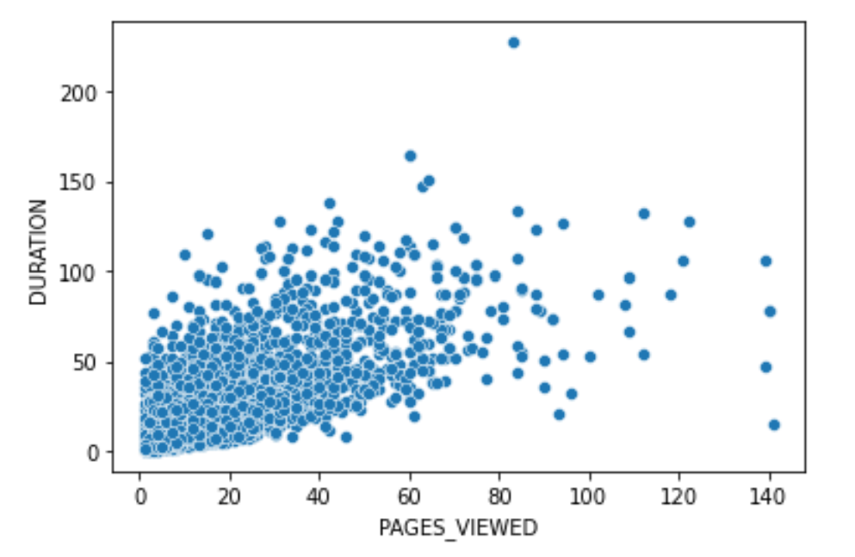
Project analysis slide 6
Scatterplot
As number of PAGES_VIEWED in a website increase, DURATION increase
Volume concentrates between 100 minutes and 70 pages viewed
Interpretation
Users going through multiple pages before deciding on a hotel to book
Users spending less time while looking for locations that suit their needs
Longer time can also attribute to checkout and payment process
Notes:
For our visual analysis, we created a scatterplot which shows that as the number of PAGES_VIEWED on a website increases, the DURATION increases at a steady rate. We can also see that the bulk of transactions concertante between 100 minutes and 70 pages viewed. We interpreted this as:
Users going through multiple pages before deciding on a hotel to book, Users spending less time while looking for locations that suit their needs, and Longer time can also attribute to checkout and payment process

Slide 7
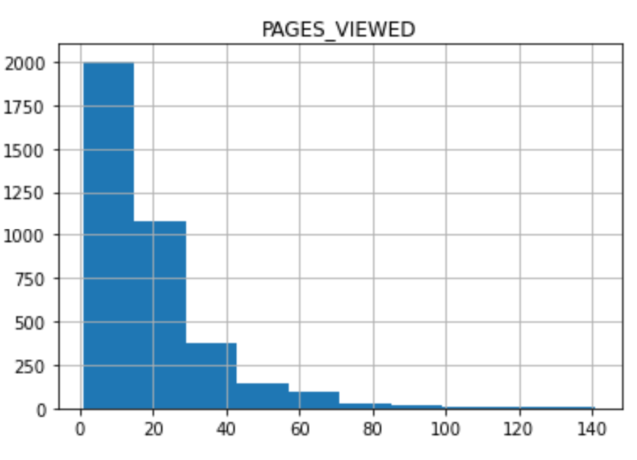
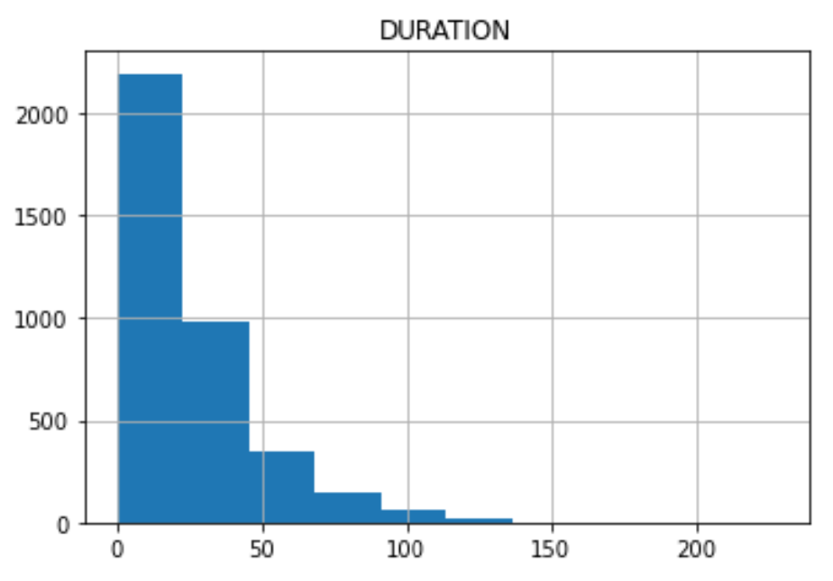
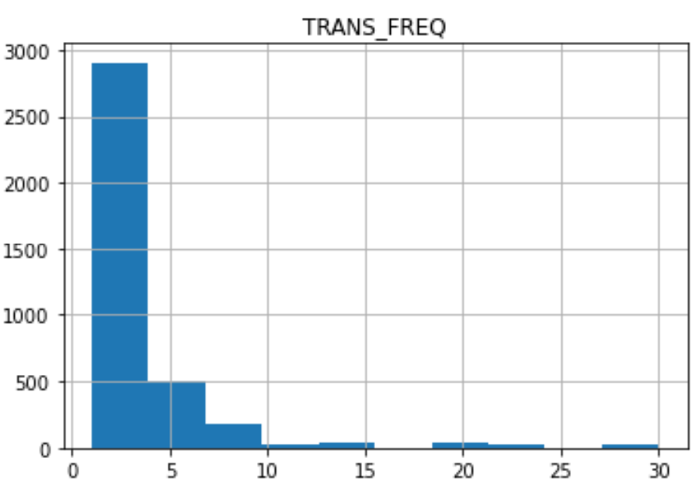
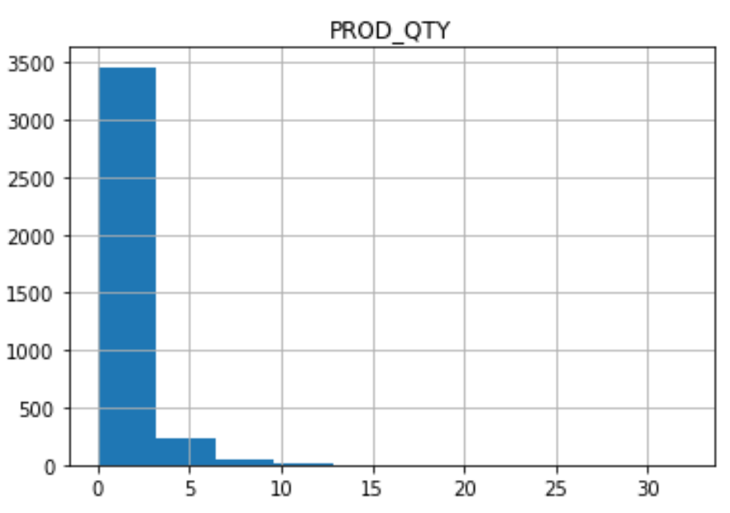
Project analysis slide 7
Histograms
Observations
All histograms have relatively the same shape
Observations compliment data as it has already been analyzed
TRANS_FREQ shows gaps between actual number of transactions made between households
PROD_QTY shows that almost all purchases have less than 3 products, hints at small households or the use of travel packages
Notes:
Our last visual tool was histograms, here we choose to focus on PAGES_VIEWED, DURATION, PROD_QTY, and TRANS_FREQ, as they most directly help us to reach our goal in answering our question.
With these we made some observations. First, we see that all of the histograms have relatively the same shape. With just about over 3000 transactions, a majority of them are skewed toward taking less time, less pages, and less products depending on the histogram. We also found that these observations compliment data as it has already been analyzed on the previous slides.
Next, in TRANS_FREQ, we see gaps between actual number of transactions made between households showing that most either don’t spend as much or don’t intend on making several bookings.
Lastly, in PROD_QTY, we see that almost all purchases have less than 3 products, hints at small households or the use of travel packages

Slide 8
Regression Analysis
Notes:
Our regression analysis reports on two primary business questions, which we hypothesize has an association with revenue

Slide 9
Project analysis slide 8
Part A
Why do some people spend more time booking hotels?
DV (what we want to know about)
IV (what we think is influential)
PROD_QTY
DIRECTP_D
DURATION
Notes:
The first question, is why do some people spend more time booking hotels?
From a statistical perspective, we place what we want to know as our DV (dependent variable) and what we ‘think’ is acting as an influential factor as our independent variable or variables.
In this case, we want to know about the time people spend booking hotels. So, ‘DURATION’ becomes our dependent variable. Since, from a logical perspective we think the amount of product being purchased (PROD_QTY) and whether or not individuals are purchasing from a direct or third-party site (DIRECTP_D) are influential factors, they become our independent variables.

Slide 10
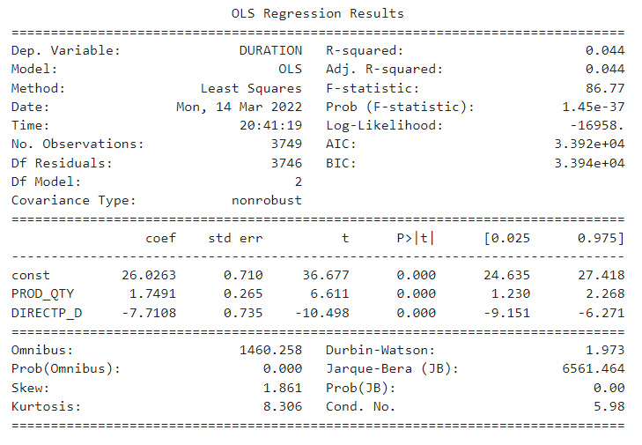
Project analysis slide 8
Regression Results
Notes:
The visualization on this slide depicts our overall regression for the hypothesis we’ve proposed, which again is that PROD_QTY and DIRECTP_D are influential factors on DURATION.
The first thing we observe here is that our p-values are above 0.05 (in red). This demonstrates that the two IVs are in fact statistically significant, or in other words, the numbers are telling us that there’s a correlation or relationship between our DV and IV.
Because of this, we’re able to move onto our coefficients. These numbers show us strength and directionality in terms of how the IV is influencing the DV. For PROD_QTY, as it increases by 1 unit or %, the DV (time) increases by 1.74. In other words, as the amount of products being purchased increases by one ‘unit’, time increases by 1.7 seconds.
Alternatively, in the case of whether an individual purchases from a direct or third party site, this coefficient demonstrates that as DIRECTP_D increases by one unit, the duration of time DECREASES by 7.71. We can ultimately conclude that DIRECTP_D has a higher magnitude in terms of impact on duration, but overall both IVs are influential and due to the logical relationship between the two factors, we can confidently conclude that there is a causal relationship between PROD_QTY and DURATION, and DIRECTP_D and DURATION.

Slide 11
Project analysis slide 8
Part B
Why do some people visit more pages when booking hotels?
DV (what we want to know about)
IV (what we think is influential)
PROD_QTY
TRANS_FREQ
PAGES_VIEWED
Notes:
Our second question, is why do some people visit more pages when booking hotels?
For this particular question, we want to know what factors influence an individual to view more pages and we’ve determined that the amount of products an individual purchases (PROD_QTY) and the frequency of transactions from a given household in the year of 2011 (TRANS_FREQ) are our top influential factors, at least at this point from a logical perspective.

Slide 12
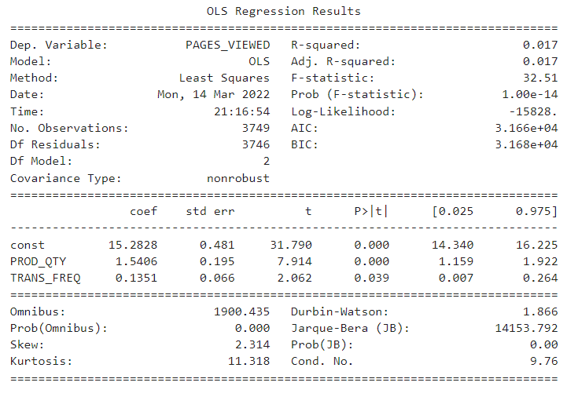
Project analysis slide 8
Regression Results
Notes:
Our regression results here prove that our two selected IVs are statistically significant by their p-values and that they have an impact on our DV. We can see here that the magnitude is not incredibly large, but it does have an overall influence. This perhaps alerts us that we are under utilizing the data in terms of these influential factors and the magnitude they could have on our dependent variable.

Slide 13
Project analysis slide 2
Recommendations
What are our next business moves?
MORE TIME ON SITE = $$$
THIRD PARTY > DIRECT WEBSITE
PAGE COUNT ‘Sweet Spot’
Increase connection or previous purchasers
Notes:
In terms of future business moves, we recommend looking into innovative ways to increase time spent on the website, as we can confidently conclude that individuals who spend more time on a website tend to spend more money. The reasons would need further analysis, but ideas could be due to concern that one may ‘lose a deal’ if they don’t ‘act now’ or that the customer might be more willing to spend more money after viewing the high cost of other hotels.
The company should also maintain ways of getting customers to visit third party sites over direct sites, which can be done via top search ads.
We surmise that there is a ‘sweet spot’ in terms of how many pages are optimal to gauge a customer. If they click on too few pages, they might see a competitors site and choose to make their purchases there. If they view too many pages, they may feel overwhelmed and end up not making any purchases. This could be regulated through an algorithm which creates more ads as less pages are viewed and less ads are more pages are viewed.
Lastly, since the data show that prior customers tend to view more pages, and we know that there is a correlation between that and products purchased, a more aggressive approach to engaging previous customers. We can increase the impact by sending more emails, providing more incentive to come back to the website, and even over new ‘free’ products, such as txt alerts, rewards, and other perks.

Slide 14
Thank You
Notes:
We hope our data analysis was informative to you, and that it helps you move in the right direction to enhance your business.

